Slide 1

Introduction to
Travel Risk Management
Presented by GBTA’s
Travel & Meetings Risk Management Committee
Joshua Rose
Director, Strategic Accounts
Global Rescue
Notes:
Thank you. Thank Leigh and Mary Ellen
2 hats – GBTA TMRM Committee and Global Rescue
Discussion
Duty of care
Travel Risk Management
Assessing where your organization is
Reasons why travel risk management fails
Egypt
Questions

Slide 2
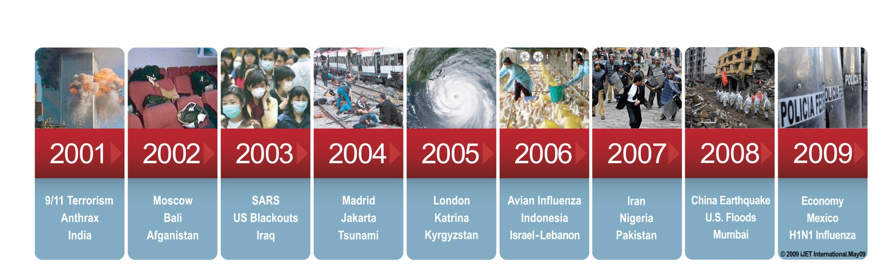
Introduction to risk management
Since 911, organizations have had to deal with both the perception and the reality that there are increased risks to their employees and business operations around the world
Notes:
natural disasters, accidents, illness, terrorism not new
More businesses are global, more events impact them
2010 – Ash cloud, Haiti, Chile earthquake
30 years ago, an ash cloud in Europe or a riot in Cairo had little impact on U.S. businesses
Also more media awareness today
- the types of threats
- increasing frequency and severity.
“new normal”

Slide 3
Reality check
What are the odds?
Dying in an airplane accident = 1 in 10.87 million
(top 25 airlines)¹
Dying in a terrorist attack = 1 in 9.3 million³
Dying by choking on food = 1 in 4,293²
Dying from exposure to smoke or fire = 1 in 1,167²
Dying by accidental drowning = 1 in 1,140²
Dying in a motor vehicle accident = 1 in 84²
¹ OAG Aviation & PlaneCrashInfo.com accident database, 1985 - 2009
² National Safety Council (2004) – lifetime risk
³ National Safety Council – historical odds
Notes:
Media is sensationalist – 24 hr news cycle
Worst case scenarios highlighted, but rare – terrorism, plane crash
Issues like Egypt make the news, but many other ways that travelers can be negatively effected while traveling
<On click>
Most common are: health issues/accidents, weather issues, and petty theft
Risk management plans must address routine issues and catastrophic

Slide 4
Medical risks
65% of travelers will report a medical problem
8% will seek care
Lack of medical standards internationally
Case Study: Traveling Employee’s Preventable Death
U.S. national in Saudi Arabia
Suffered cardiac condition requiring surgery
KSA hospital had never previously performed the procedure, patient died
Likely would have survived if procedure had been done in US
Result: Millions of dollars in liability for employer

Slide 5
Why should travel managers care?
Defining duty of care
Organizational responsibility
Legal statutes, past court decisions, workers’ compensation regulations, corporate social responsibility
Obligation to provide a safe work environment
Extending to travel - “If you’re sending them, you’re responsible for getting them back home”
Notes:
ASK: Who’s heard of duty of care? What is it?
<On click>
Organization has:
- legal – in US, no clear laws, but past decisions. Elsewhere varies – UK corporate manslaughter law
- financial
- moral
Obligations
- what is safe?
- what would be prudent? (must disclose risks to let travelers make prudent decisions)
- what do others in industry do?

Slide 6
Defining travel
Any time an employee leaves the office on official business
Risk types
Risk to personnel
Risk to operations / productivity
Risk to data / equipment
Financial / legal risk
Risk to reputation
Notes:
ASK: How do you define travel? (Roomful of trav managers and suppliers)
<On Click>
Duty of care - any time employee leaves office on business
<On click>
How could travel impact these general risk areas?
ASK:
Personnel: illness, injury while abroad
Operations/Productivity: loss of critical business traveler, supply chain failure
Data/Equipment: Data loss, computer theft
Financial/Legal: Loss of trip expenses, costs associated with liabilities / benefits
Reputation: product failure, scandal
Travel and organized meetings carry these risks (meetings risk is higher, because of high number of VIPs and publicized dates / times)
First rule – take care of people

Slide 7
Cross-functional support critical to success
Organization
Travel Department
Human Resources / Legal
Security Department
Medical Department
Risk Management / Biz Continuity
Global data consolidation and reporting
Compliance monitoring
Pre-trip training
Pushed alerts
Standards of care
Auditable systems
Risk disclosure
Lower liability
Policy and procedures
Corporate insurance programs
Risk assessment and predictive intelligence
Incident notification
Crisis and evacuation plans
Coordinated response
Pre-trip health planning
Immunizations
Medical assistance and evacuation for international travelers
Plan development and implementation
Monitor assets at risk
Notes:
Multiple company departments
ASK: who is here from travel? HR? Sec? Med? Risk Management?
Who should be driving this?
Travel manager are the champion to drive the process, but you can’t do it alone
Communication is critical to having a successful plan
And getting buy-in from management is essential

Slide 8
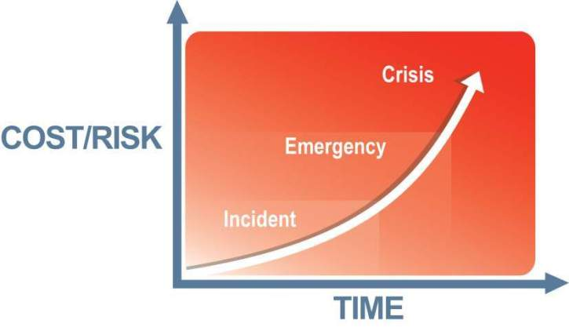
Your organization needs a plan for travel risk
Reduced risk & cost = competitiveness
“Optimal response”
Notes:
First rule not people, its stockholders
Risk management is one area where these two rules align:
Not taking care of people drives up costs
Disruptions impact business continuity
Increase cost to a company
The longer it takes you to respond to an incident, the greater the cost to the organization
The objective is to minimize cost – and the only way to do this is to address preparedness
Having a plan and the ability to respond to any disruption quickly can have a dramatic effect on the cost impact to your company
Example:
A cigarette thrown into a trash can causes a fire:
If it is put out right away (throw coffee on it), then it is a minor local incident
If the fire suppression system kicks in, people are evacuated, then it is an emergency
If the fire suppression system is inactive, escape routes are blocked, lack of response that results in property loss, injury, and/or death, then this becomes a crisis
Policy: No smoking. Don’t throw lit cigarettes into a trash can

Slide 9
Organizational travel risk management:
Proactive
_{Feedback}
Planning
Training
24x7
Monitoring
Incident
Response
Reactive
Notes:
2 parts to mitigate risks for travel: Proactive and Reactive
Proactive
Policy creation (no more than # on flight, no travel to certain countries)
Training (travelers and expat, managers, response team);
Monitoring of threats, locations, communication
Planning and training change behavior, have highest ROI: Bin drinkin v. Bin Laden
Monitoring: External issues may impact – how?
Incident Response
Feedback loop: Co w/ large number of young contractors found that most incidents occurred at 2 am. Made midnight curfew.

Slide 10
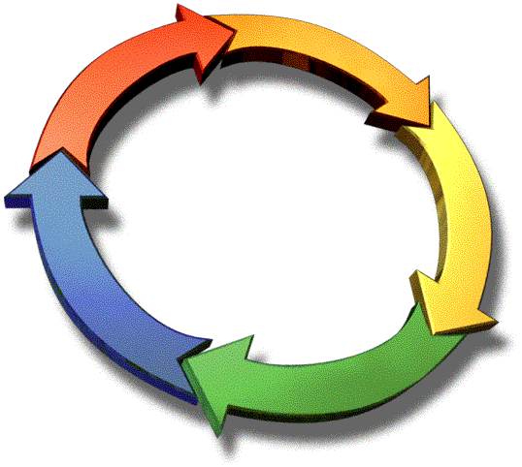
Traveler safety continuum
Policies / Procedures
  Crisis management plans
  Policy / compliance
  Enterprise communication
  Health plan, vaccinations
Track Employees
  Employee profiles
  Automated and verified
  Real-time alerting
Hotline
  24 x 7
  One call
  Company-specific protocol
  Travel, security, health
Training
  All employees
  Management team
  Personal protection
  Country / region specific
Medical Service
  In-country, Western-quality care
  Evacuation
Access to Intelligence
  Travelers
  Management (push)
  Assess risks/set ratings
  Pre-trip (pull)
  During travel
Security Service
  Executive protection
  Escorts
  Guards
  Evacuation
Notes:
Travel Risk Management is “a process, not an event”.
Elements –
Policies
Training
Intel
Tracking
Hotline
Medical support
Security support

Slide 11
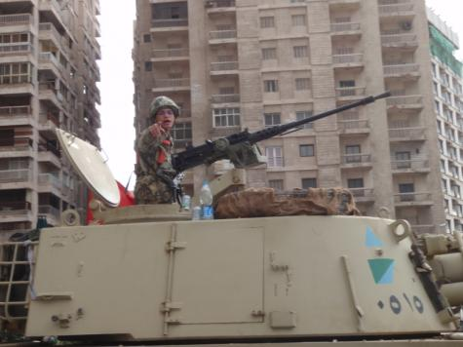
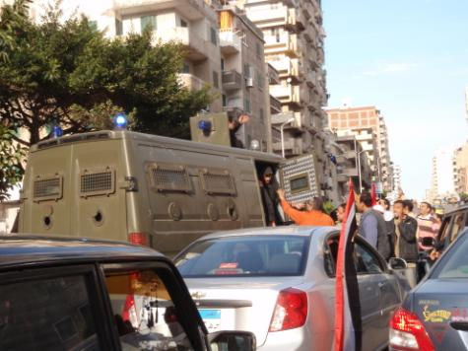
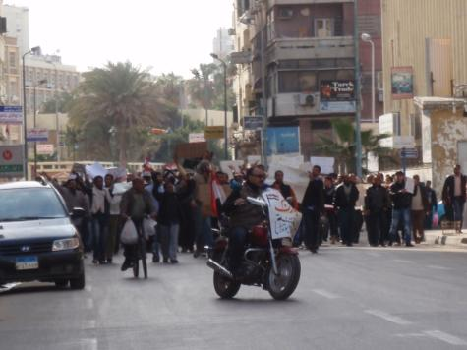
Mission Summary
Egypt – January, 2011
Photos taken on-location by Global Rescue Operations personnel
Deployment of in-house security personnel
Activation of contracted local assets
Simultaneous extraction of multiple clients
Evaluation, fortification, and security of shelter-in-place locations
Multi-vehicle security convoys with armed military escorts
Air, water, and overland extraction routes
Unified command center
Notes:
Egypt:
- almost 200 evac’d
- SEALS on the ground starting Saturday
- Local drivers, sec personnel
- Protected during curfew hours
- Armed military escorts for convoys
- Air, land, sea evac routes
- All coordinated in BOC
- Evacs Sat, Sun, Mon, Tues

Slide 12
Organization Self - Assessment
Travel Risk Management Maturity Model (TRM3)
The TRM3TM assesses an organization’s travel risk management program
Model describes maturity based on key process areas (KPAs)
Provides guidance on improving an organization’s program over time
Free resource for GBTA members on the website
TRM3 is a trademark of iJET International, Inc.
Notes:
Travel Risk Management Maturity Model
- Built by GBTA and partners
- Lets orgs assess where they are
- Shows areas for improvement
ASK: Has anyone done this self test?
I can send it to anyone interested.

Slide 13
TRM3TM – 10 key process areas (KPAs)
Policy / Procedures
Overarching KPAs
Management KPAs
Infrastructure KPAs
Training
Risk
Assess-ment
Risk
Disclosure
Risk
Mitigation
Risk Monitoring
Response
Notification
Data Management
Communication
TRM3 is a trademark of iJET International, Inc.
Notes:
These KPAs drive the program, and each can be running at a different level.
Policy & Procedures: Continual Process, annual review, insurance, etc.
Training: Training continual – for traveler, meeting attendee, crisis management team –drills / table tops
Risk Assessment: I’m going to Antarctic. Is there a risk?
Disclosure: Have you told me about the risk? Do I know that it’s going to be really cold?
Mitigation: Do I have appropriate clothing, food, shelter?
Risk Monitoring: There is a storm coming. Pull me out or keep me in?
Response: What if you have to push the red button?
Notification: I know about some bad things. Who do I tell and how? What if the person I need to contact isn’t there? Is there a backup?
Data Management: Who has 100% data accuracy? Contact information is often an issue. Do you know where they are staying? Do you know who they are visiting?
Communication: process to inform me, managers, crisis team, family, etc?
Every time something happens in the world (earthquake, storm, bombing) that is an opportunity for you, as a travel manager, to reinforce what should be done should that type of event occur.

Slide 14
Top 10 reasons things fail . . .
#10: Company does not know what to do in an emergency
Don’t be reactive. Get a basic plan in place and make sure you know where to get help
#9: Out of date contact numbers
Get contact numbers (cell, home, office, email, IM, etc.) for the people that you need in an emergency. Periodically have them verified and updated
#8: Primary and backup person are not available
This happens frequently. Try to have multiple backup contacts. Think about people who are normally available
Notes:
14
Why do things fail?
#10 – Co. doesn’t know what to do / don’t be reactive
#9 – Out of date contacts / verify frequently
#8 – Prim and backup not available / common problem – have multiple backups for 3 am on Sat morning

Slide 15
#7: Cell phones don’t always work
We are becoming totally reliant upon cell phones. Employees should have a calling card, know how to use text (SMS) messaging, and have a satellite phone for rural assignments
#6: Third-party response resource does not know what is going on
Talk to your vendors. Include them in your planning. Run exercises and drills
#5: No response resource retained
Make a list of incident types and answer the question “Who would I turn to?”
Notes:
15
#7 – Reliance on cell (saw in Egypt) / need calling cards, use SMS, sat phones, sat tracking
#6 – Response service not in loop / keep vendors involved in planning (we like it)
#5 – No response service (who?)

Slide 16
#4: Protocols are not maintained
Companies need to periodically review their plans and protocols, at least annually
#3: Protocol or procedure is too complex
Look to streamline the process. In the event of an emergency, you will only have time and bandwidth for the basics
#2: Inconsistent skill level within the team
Crisis and emergency management is not the core competency of most businesses. Get training for the core team that will be called upon to deal with an emergency
Notes:
16
#4 – Protocols not maintained / review annually
#3 – Procedure too complex / keep it simple
#2 – Inconsistant skill level (some want to be part, some have to be) / train, get consultants, drill

Slide 17

#1: Cost sensitivity delays response
Deal with where the funds will come from and who will pay BEFORE the event! A delay in response increases costs and can even cost lives
Notes:
17
#1 – Cost sensitivities / run scenarios prior, make arrangements. Response can be expensive, or can be no cost at all.

Slide 18
Summary
Your program must:
Identify and evaluate the risk
Identify your resources
Set an acceptable level of risk
Develop a plan for mitigating the risk
Educate and communicate the plan
Monitor the results
Notes:
Travelers will be complacent and won’t be concerned
You shouldn’t be
last bastion of defense to make sure that bad things don’t happen!
Your target should be a Level 3 baseline program
If you’re sending them, you need to get them out

Slide 19
Resources
1-617-459-4209 jrose@globalrescue.com
Travel Risk Management Maturity Model (TRM3TM)
GBTA Foundation’s Managed Travel Index & Benchmarking Tool (includes travel risk management self-assessment) – now FREE to GBTA members
Certified Corporate Travel Executive (CCTE) Core Week II module
Webinars
Further resources being developed by GBTA’s Travel & Meetings Risk Management Committee
TRM3 is a trademark of iJET International, Inc.

Slide 20
Questions?

Slide 21
Only Global Rescue has the ability to positively change outcomes
Traditional
model
By telephone
model
Layperson call screeners, frequently offshore
Local admitting physician
In-house physicians
Patient must be admitted to a hospital
Johns Hopkins Medicine
Global Rescue’s paramedics & physicians
US based paramedics and security experts
Through deployed
on-site personnel
Field Rescue services
Who answers the phone?
Who makes the decision regarding the need for evacuations?
Who provides expert third-party medical oversight?
What are the requirements to access a patient?
How is information gathered and services managed?

Slide 22
How do these differentiators save lives?
September, 2008: Hong Kong
Highly contagious bacterial meningitis
  Potentially lethal condition if not treated appropriately
  Initial treating facility inexperienced with these cases
  Immediate movement to regional Center of Excellence followed
  by evacuation to home hospital
  Required Response Resources
Deployed medical personnel led care
Expert physician and specialist consultations
Evacuation to home hospital
Communication between all stakeholders, including government authorities to coordinate quarantine

Slide 23
How do these differentiators save lives?
January, 2010: Port au Prince, Haiti
Natural Disaster
  Sudden onset of devastating earthquake
  Air and seaport damage
  Rapid escalation of looting and violence
  Required Response Resources
Dedicated team of security professionals
Integrated medical / security resources
Local personnel and developed resources
Boots-on-the-ground personnel
Government relationships
Unconventional extraction

